Slide 1
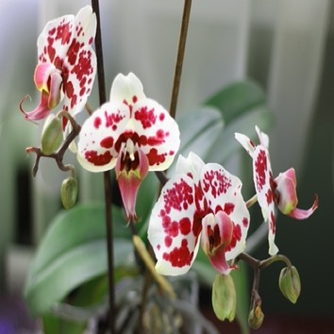
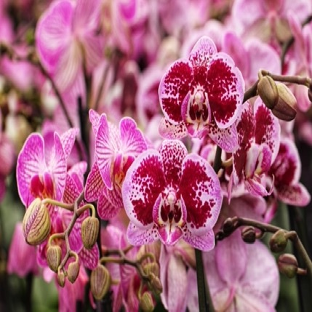
Smart Grow
Grow your plants, take pictures and create NFTs.

Slide 2

Introducing
Smart Grow
Smart Grow is a mobile application that allows users to lead a journal of plant growing. Through the application users can define areas (such as rooms, gardens, etc.) where plants are located, and define which plants they grow at specific locations. Application features a smart notification system, users are able to set up watering notifications for their plants. For each plant users can add journal notes, such as when flowers will bloom, etc. With the app users are able to take pictures of their flowers and plants, and store them as NFTs. This is a unique way to store memories about beautiful plants and fun times you had growing them.

Slide 3
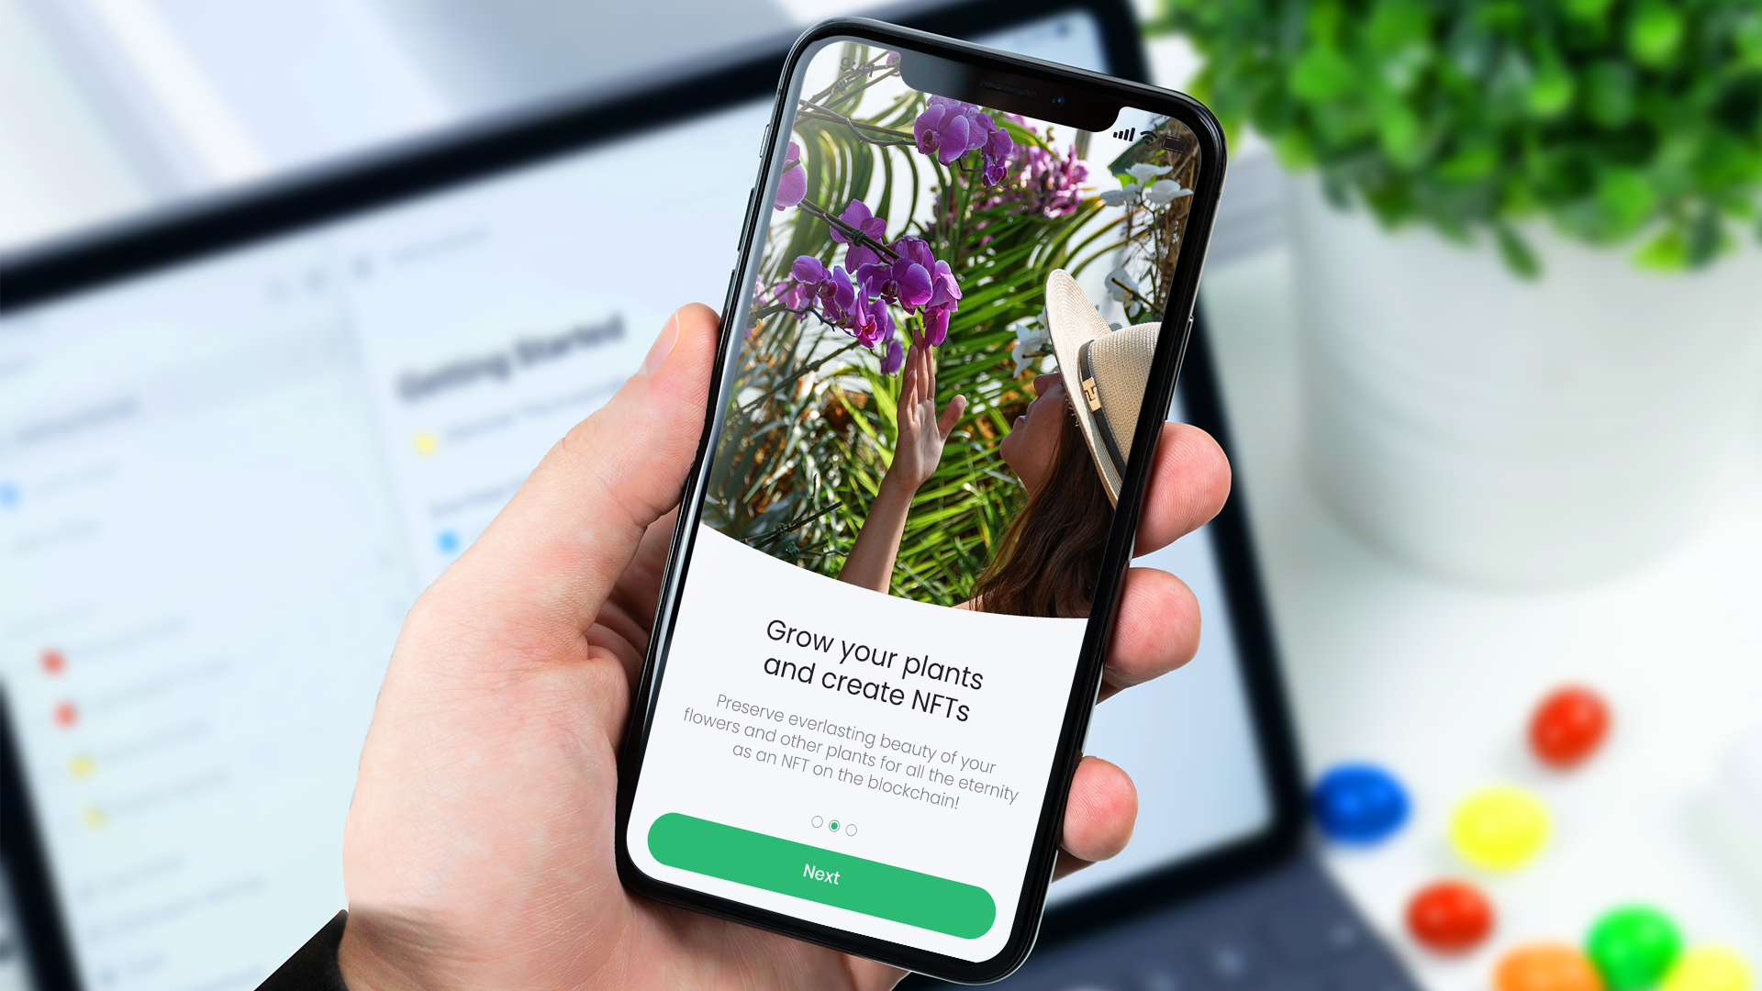

Slide 4
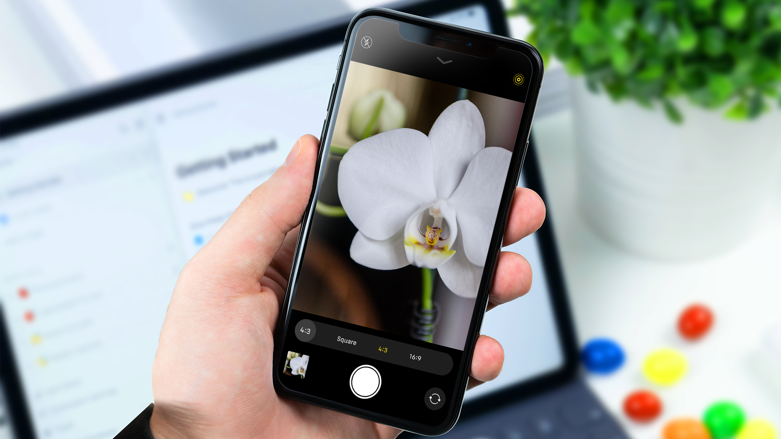

Slide 5
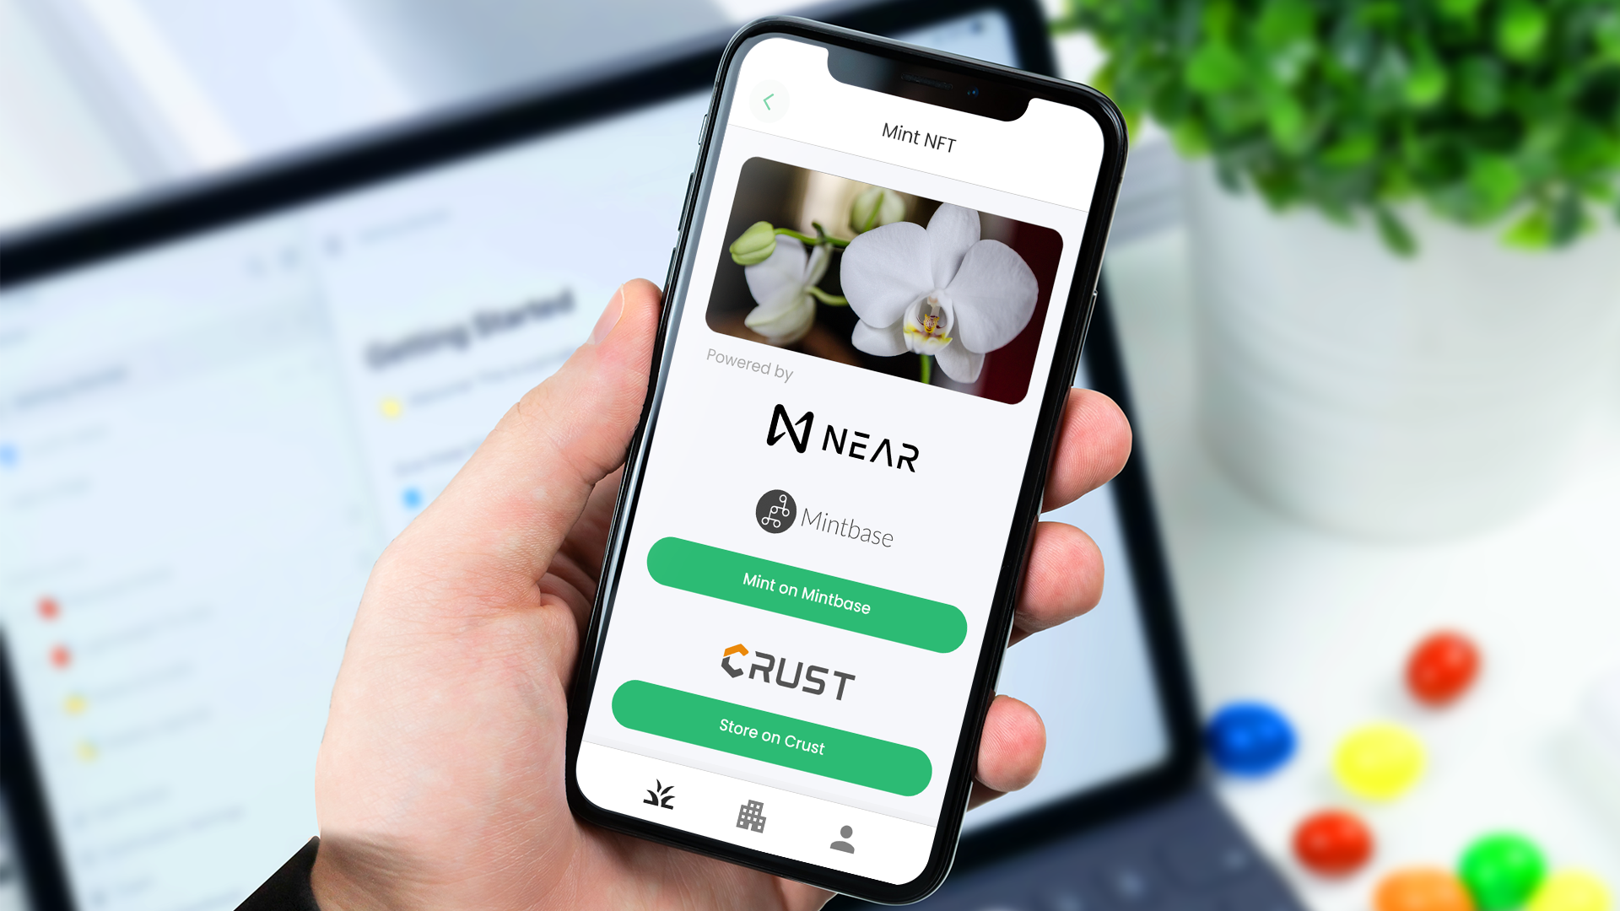

Slide 6
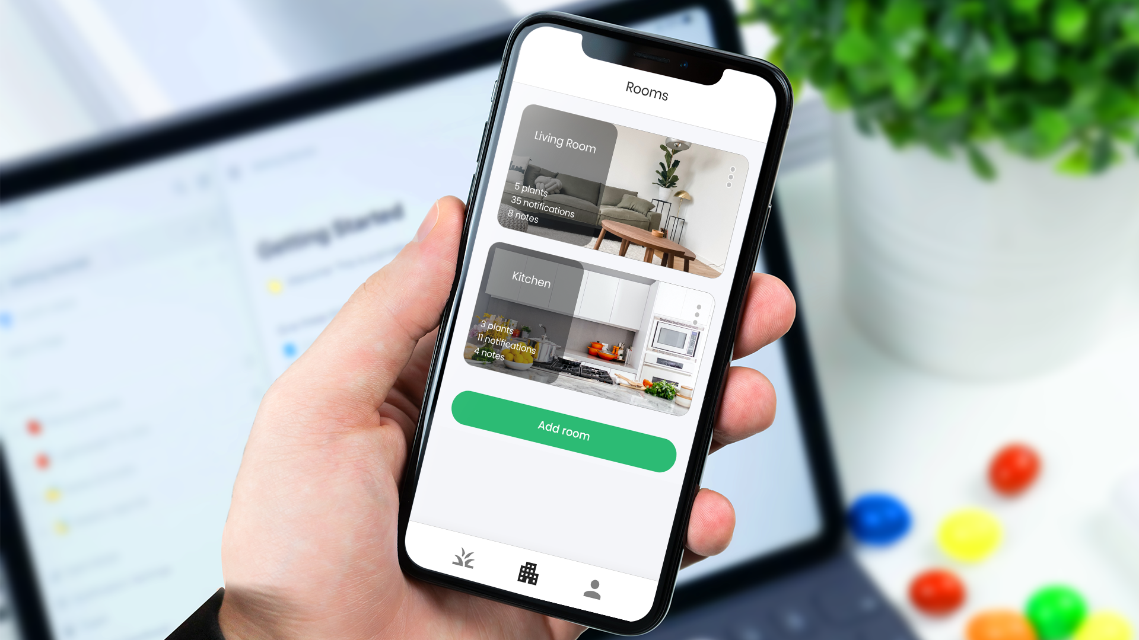

Slide 7
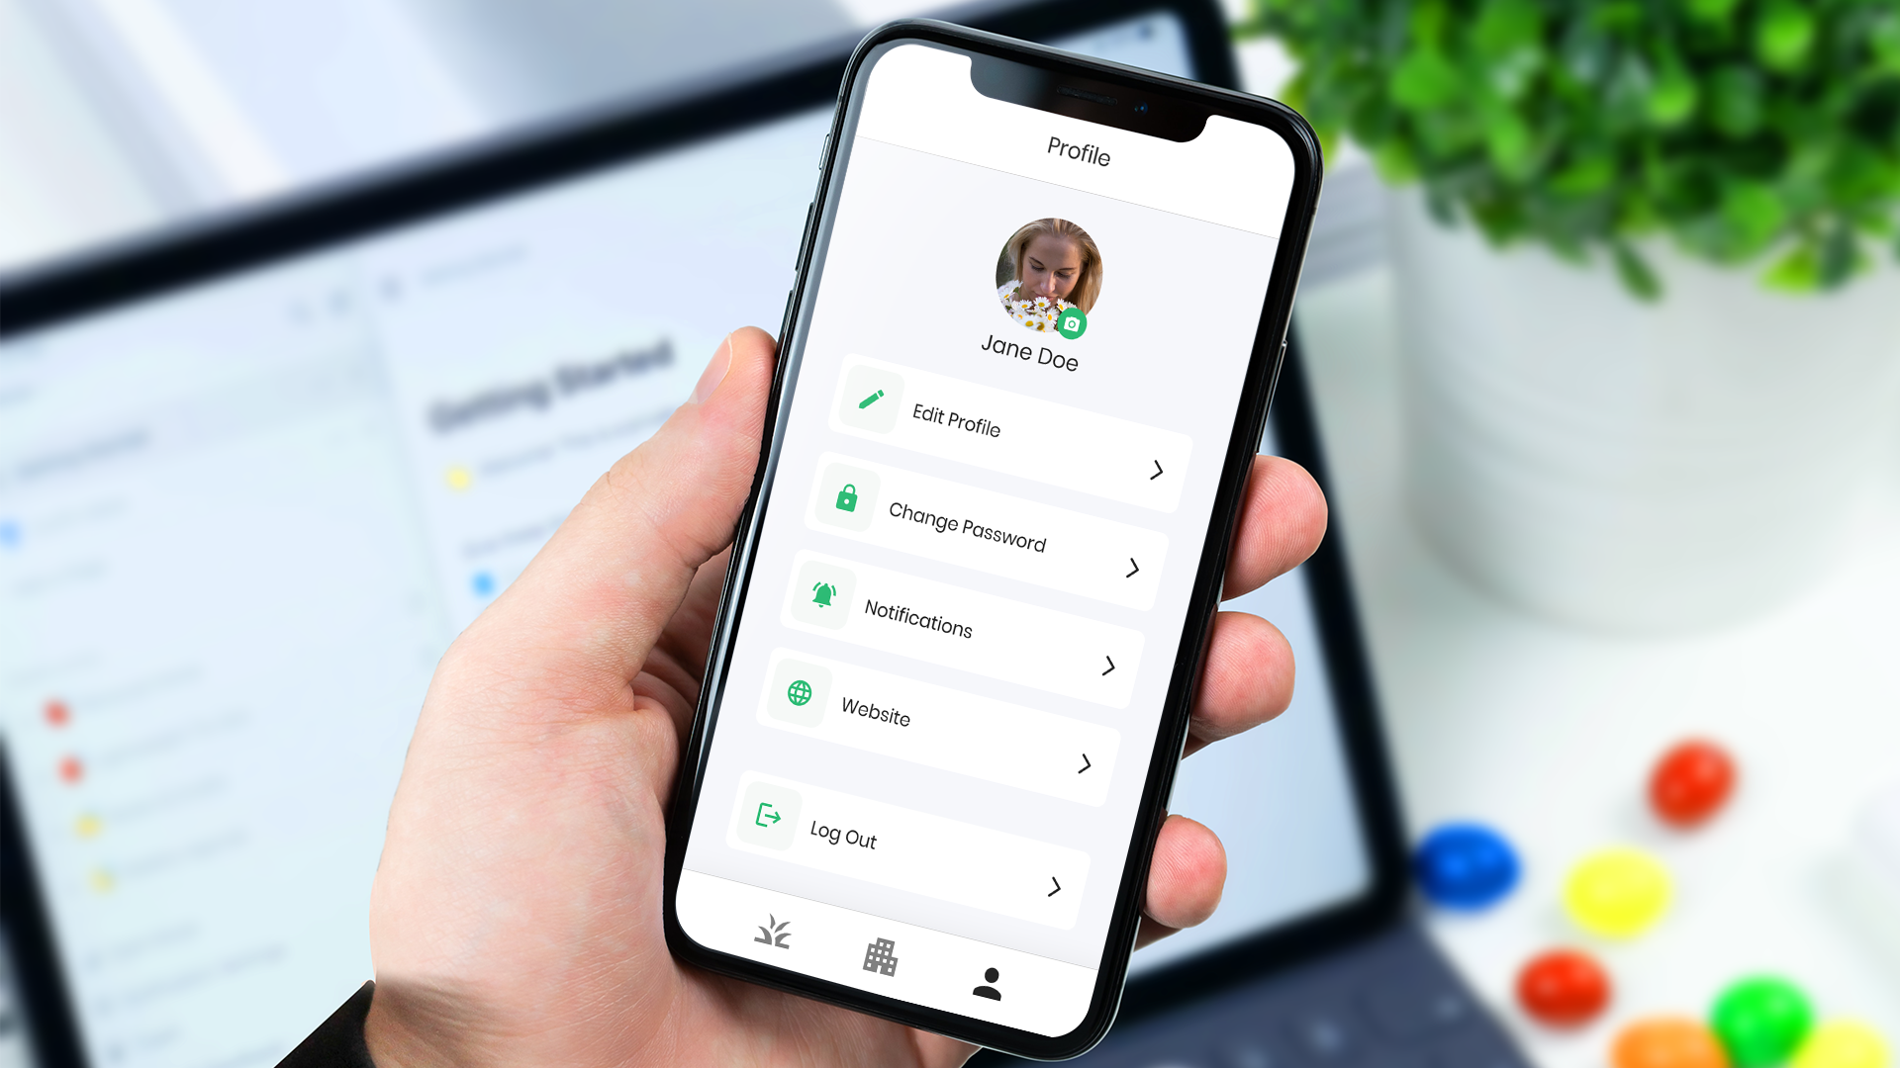

Slide 8


Meet
The Team
Nenad is result driven professional working in the fintech field for more than 15 years. His technologies of expertise are SQL, PL/SQL, DWH and BigData analytics, and reporting solutions.
Goran is Microsoft AI MVP; he has 15 years of work experience in IT and wide knowledge about various technologies. He is a tech enthusiast, and he likes to share his wide knowledge on different workshops and conferences.
Nenad Kovacevic
Goran Vuksic

Slide 9



Thank You!

